Slide 1
CHAPTER 7
SAMPLING DISTRIBUTIONS
Prem Mann, Introductory Statistics, 8/E Copyright © 2013 John Wiley & Sons. All rights reserved.

Slide 2
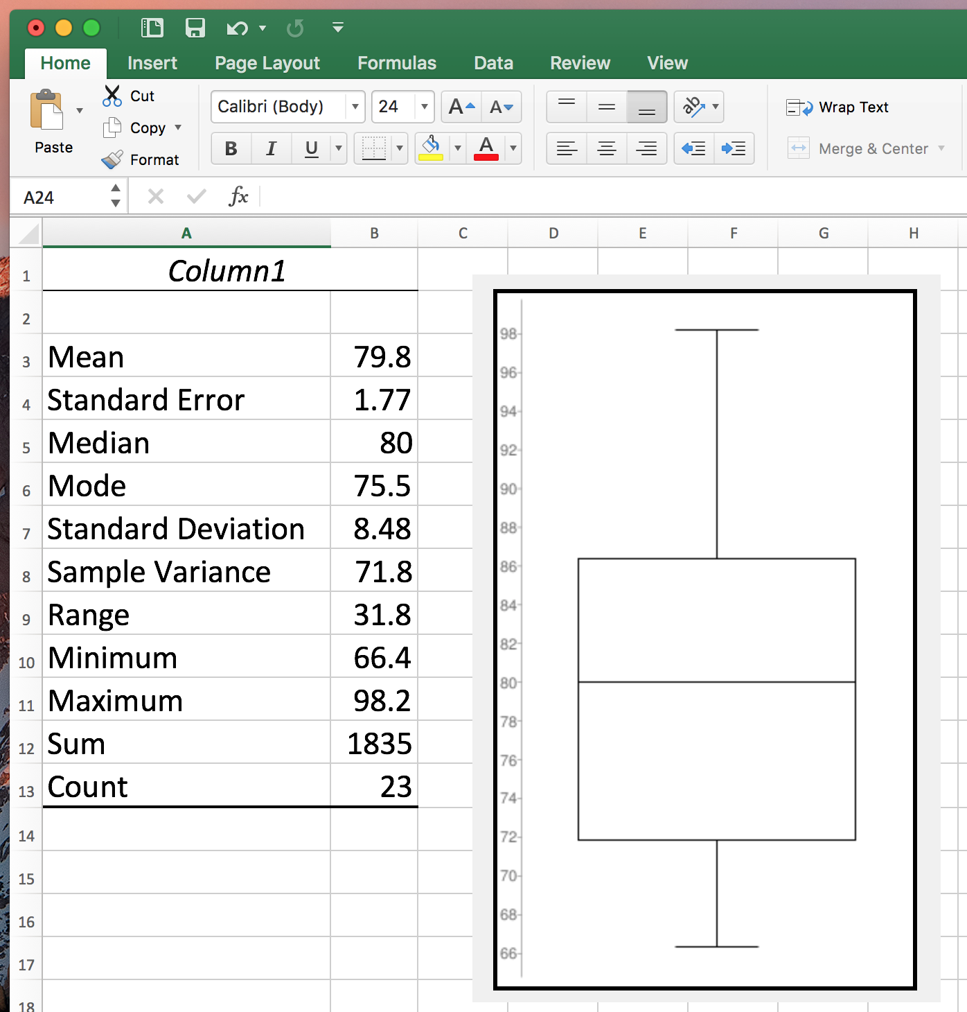
Exam I Statistics

Slide 3
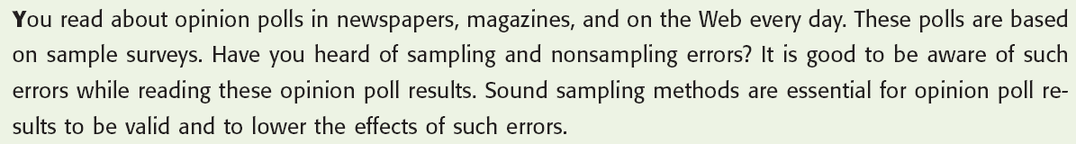
Opening Example
Prem Mann, Introductory Statistics, 8/E Copyright © 2013 John Wiley & Sons. All rights reserved.

Slide 4

SAMPLING DISTRIBUTION, SAMPLING ERROR, AND NONSAMPLING ERRORS
Population Distribution
Sampling Distribution
Prem Mann, Introductory Statistics, 8/E Copyright © 2013 John Wiley & Sons. All rights reserved.

Slide 5
Population Distribution
Definition
The population distribution is the probability distribution of the population data.
Prem Mann, Introductory Statistics, 8/E Copyright © 2013 John Wiley & Sons. All rights reserved.

Slide 6
Population Distribution
Suppose there are only five students in an advanced statistics class and the midterm scores of these five students are
  70 78 80 80 95
Let x denote the score of a student
Prem Mann, Introductory Statistics, 8/E Copyright © 2013 John Wiley & Sons. All rights reserved.

Slide 7
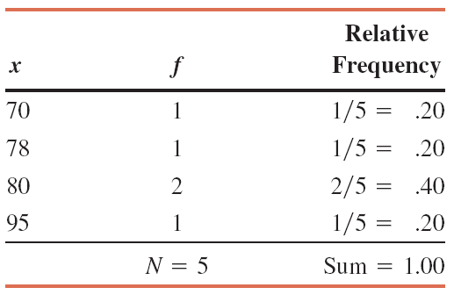
Table 7.1 Population Frequency and Relative Frequency Distributions
Prem Mann, Introductory Statistics, 8/E Copyright © 2013 John Wiley & Sons. All rights reserved.

Slide 8
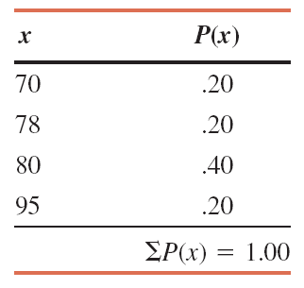
Table 7.2 Population Probability Distribution
Prem Mann, Introductory Statistics, 8/E Copyright © 2013 John Wiley & Sons. All rights reserved.

Slide 9
Sampling Distribution
Definition
The probability distribution of is called its sampling
distribution. It lists the various values that can assume
and the probability of each value of .
In general, the probability distribution of a sample statistic is
called its sampling distribution.
Prem Mann, Introductory Statistics, 8/E Copyright © 2013 John Wiley & Sons. All rights reserved.

Slide 10
Sampling Distribution
Reconsider the population of midterm scores of five students given in Table 7.1.
Consider all possible samples of three scores each that can be selected, without replacement, from that population.
The total number of possible samples is
Prem Mann, Introductory Statistics, 8/E Copyright © 2013 John Wiley & Sons. All rights reserved.

Slide 11
Sampling Distribution
Suppose we assign the letters A, B, C, D, and E to the scores of the five students so that
  A = 70, B = 78, C = 80, D = 80, E = 95
Then, the 10 possible samples of three scores each are
  ABC, ABD, ABE, ACD, ACE, ADE, BCD, BCE, BDE, CDE
Prem Mann, Introductory Statistics, 8/E Copyright © 2013 John Wiley & Sons. All rights reserved.

Slide 12
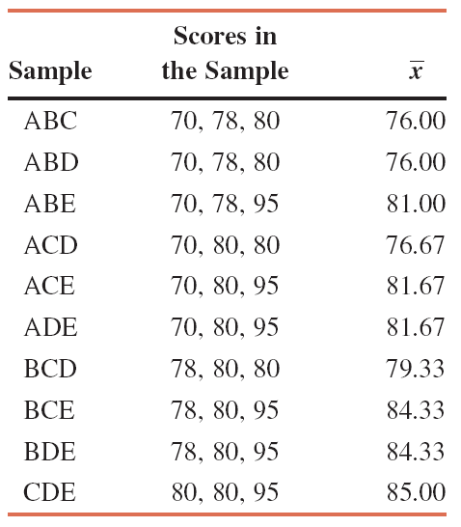
Table 7.3 All Possible Samples and Their Means When the Sample Size Is 3
Prem Mann, Introductory Statistics, 8/E Copyright © 2013 John Wiley & Sons. All rights reserved.

Slide 13
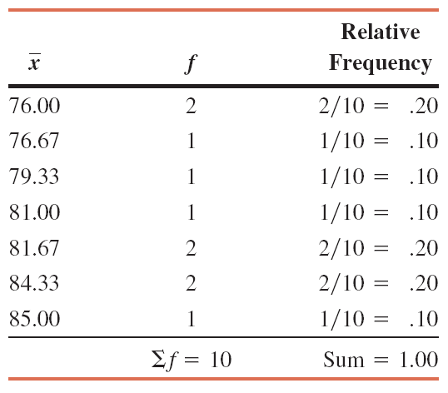
Table 7.4 Frequency and Relative Frequency Distributions of When the Sample Size Is 3
Prem Mann, Introductory Statistics, 8/E Copyright © 2013 John Wiley & Sons. All rights reserved.

Slide 14
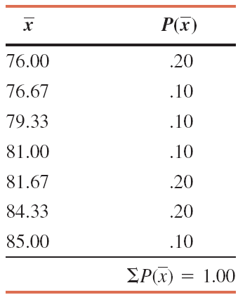
Table 7.5 Sampling Distribution of When the Sample Size Is 3
Prem Mann, Introductory Statistics, 8/E Copyright © 2013 John Wiley & Sons. All rights reserved.

Slide 15
Sampling Error and Nonsampling Errors
Definition
Sampling error is the difference between the value of a sample statistic and the value of the corresponding population parameter. In the case of the mean,
Sampling error =
assuming that the sample is random and no nonsampling error has been made.
Prem Mann, Introductory Statistics, 8/E Copyright © 2013 John Wiley & Sons. All rights reserved.

Slide 16
Sampling Error and Nonsampling Errors
Definition
The errors that occur in the collection, recording, and tabulation of data are called nonsampling errors.
Prem Mann, Introductory Statistics, 8/E Copyright © 2013 John Wiley & Sons. All rights reserved.

Slide 17
Reasons for the Occurrence of Nonsampling Errors
1. If a sample is nonrandom (and, hence, most likely nonrepresentative), the sample results may be too different from the census results.
2. The questions may be phrased in such a way that they are not fully understood by the members of the sample or population.
3. The respondents may intentionally give false information in response to some sensitive questions.
4. The poll taker may make a mistake and enter a wrong number in the records or make an error while entering the data on a computer.
Prem Mann, Introductory Statistics, 8/E Copyright © 2013 John Wiley & Sons. All rights reserved.

Slide 18
Example 7-1
Reconsider the population of five scores given in Table 7.1. Suppose one sample of three scores is selected from this population, and this sample includes the scores 70, 80, and 95. Find the sampling error.
Prem Mann, Introductory Statistics, 8/E Copyright © 2013 John Wiley & Sons. All rights reserved.

Slide 19
Example 7-1: Solution
That is, the mean score estimated from the sample is 1.07
higher than the mean score of the population.
Prem Mann, Introductory Statistics, 8/E Copyright © 2013 John Wiley & Sons. All rights reserved.

Slide 20
Sampling Error and Nonsampling Errors
Now suppose, when we select the sample of three scores, we mistakenly record the second score as 82 instead of 80.
As a result, we calculate the sample mean as
Prem Mann, Introductory Statistics, 8/E Copyright © 2013 John Wiley & Sons. All rights reserved.

Slide 21
Sampling Error and Nonsampling Errors
The difference between this sample mean and the population mean is
This difference does not represent the sampling error.
Only 1.07 of this difference is due to the sampling error.
Prem Mann, Introductory Statistics, 8/E Copyright © 2013 John Wiley & Sons. All rights reserved.

Slide 22
Sampling Error and Nonsampling Errors
The remaining portion represents the nonsampling error.
  It is equal to 1.73 – 1.07 = .66
  It occurred due to the error we made in recording the second score in the sample
Also,
Prem Mann, Introductory Statistics, 8/E Copyright © 2013 John Wiley & Sons. All rights reserved.

Slide 23
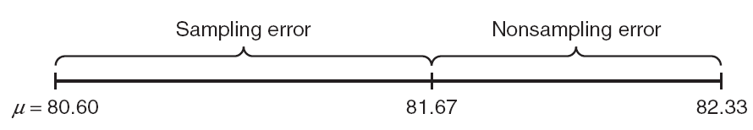
Figure 7.1 Sampling and nonsampling errors.
Prem Mann, Introductory Statistics, 8/E Copyright © 2013 John Wiley & Sons. All rights reserved.

Slide 24
MEAN AND STANDARD DEVIATION OF x
Definition
The mean and standard deviation of the sampling distribution
of are called the mean and standard deviation of
and are denoted by and , respectively.
Prem Mann, Introductory Statistics, 8/E Copyright © 2013 John Wiley & Sons. All rights reserved.

Slide 25
MEAN AND STANDARD DEVIATION OF x
Mean of the Sampling Distribution of
The mean of the sampling distribution of is always equal to the mean of the population. Thus,
Prem Mann, Introductory Statistics, 8/E Copyright © 2013 John Wiley & Sons. All rights reserved.

Slide 26
MEAN AND STANDARD DEVIATION OF x
Standard Deviation of the Sampling Distribution of
The standard deviation of the sampling distribution of is
where σ is the standard deviation of the population and n is the sample size. This formula is used when n /N ≤ .05, where N is the population size.
Prem Mann, Introductory Statistics, 8/E Copyright © 2013 John Wiley & Sons. All rights reserved.

Slide 27
MEAN AND STANDARD DEVIATION OF
If the condition n /N ≤ .05 is not satisfied, we use the
following formula to calculate :
where the factor is called the finite population
correction factor.
Prem Mann, Introductory Statistics, 8/E Copyright © 2013 John Wiley & Sons. All rights reserved.

Slide 28
Two Important Observations
1. The spread of the sampling distribution of is smaller
than the spread of the corresponding population
distribution, i.e.
2. The standard deviation of the sampling distribution of
decreases as the sample size increases.
Prem Mann, Introductory Statistics, 8/E Copyright © 2013 John Wiley & Sons. All rights reserved.

Slide 29
Example 7-2
The mean wage for all 5000 employees who work at a large
company is $27.50 and the standard deviation is $3.70.
Let be the mean wage per hour for a random sample of
certain employees selected from this company. Find the
mean and standard deviation of for a sample size of
(a) 30 (b) 75 (c) 200
Prem Mann, Introductory Statistics, 8/E Copyright © 2013 John Wiley & Sons. All rights reserved.

Slide 30
Example 7-2: Solution
(a) N = 5000, μ = $27.50, σ = $3.70.
In this case, n/N = 30/5000 = .006 < .05.
Prem Mann, Introductory Statistics, 8/E Copyright © 2013 John Wiley & Sons. All rights reserved.

Slide 31
Example 7-2: Solution
(b) N = 5000, μ = $27.50, σ = $3.70.
In this case, n/N = 75/5000 = .015 < .05.
Prem Mann, Introductory Statistics, 8/E Copyright © 2013 John Wiley & Sons. All rights reserved.

Slide 32
Example 7-2: Solution
(c) In this case, n = 200 and
n/N = 200/5000 = .04, which is less than.05.
Prem Mann, Introductory Statistics, 8/E Copyright © 2013 John Wiley & Sons. All rights reserved.

Slide 33
SHAPE OF THE SAMPLING DISTRIBUTION OF x
The population from which samples are drawn has a normal distribution.
The population from which samples are drawn does not have a normal distribution.
Prem Mann, Introductory Statistics, 8/E Copyright © 2013 John Wiley & Sons. All rights reserved.

Slide 34
Sampling From a Normally Distributed Population
If the population from which the samples are drawn is normally distributed with mean μ and standard deviation σ, then the sampling distribution of the sample mean, , will also be normally distributed with the following mean and standard deviation, irrespective of the sample size:
Prem Mann, Introductory Statistics, 8/E Copyright © 2013 John Wiley & Sons. All rights reserved.

Slide 35
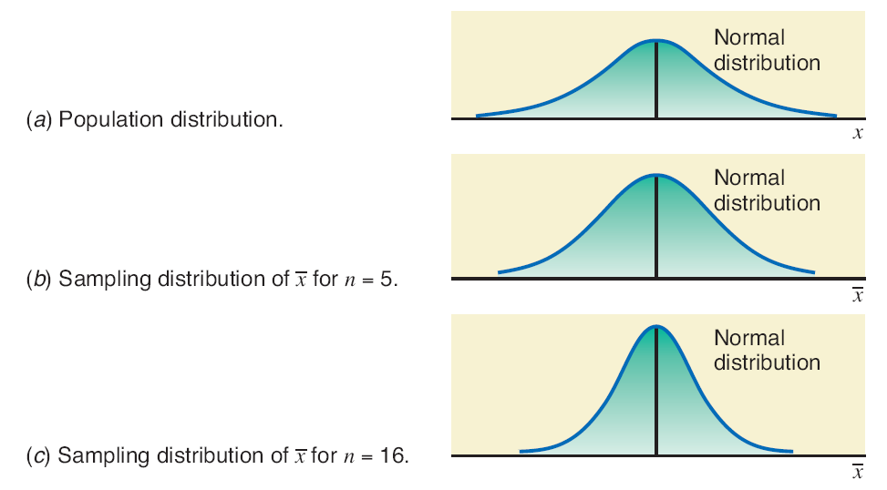
Figure 7.2 Population distribution and sampling distributions of .
Prem Mann, Introductory Statistics, 8/E Copyright © 2013 John Wiley & Sons. All rights reserved.

Slide 36
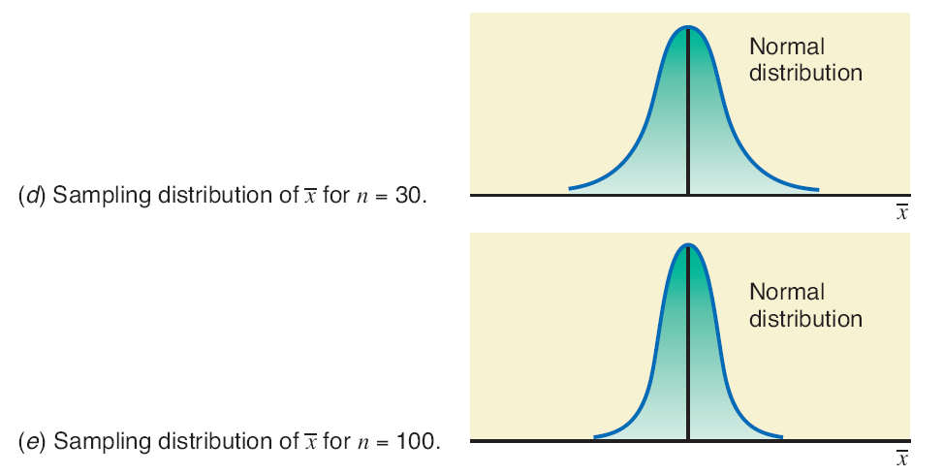
Figure 7.2 Population distribution and sampling distributions of .
Prem Mann, Introductory Statistics, 8/E Copyright © 2013 John Wiley & Sons. All rights reserved.

Slide 37
Example 7-3
In a recent SAT, the mean score for all examinees was
1020. Assume that the distribution of SAT scores of all
examinees is normal with the mean of 1020 and a standard
deviation of 153. Let be the mean SAT score of a
random sample of certain examinees. Calculate the mean
and standard deviation of and describe the shape of its
sampling distribution when the sample size is
(a) 16 (b) 50 (c) 1000
Prem Mann, Introductory Statistics, 8/E Copyright © 2013 John Wiley & Sons. All rights reserved.

Slide 38
Example 7-3: Solution
(a) μ = 1020 and σ = 153.
Prem Mann, Introductory Statistics, 8/E Copyright © 2013 John Wiley & Sons. All rights reserved.

Slide 39
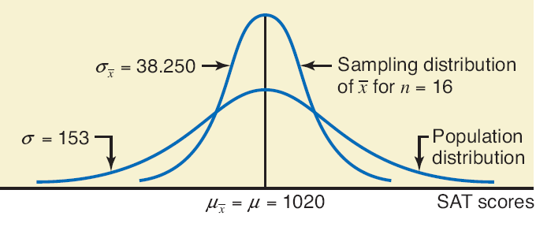
Figure 7.3
Prem Mann, Introductory Statistics, 8/E Copyright © 2013 John Wiley & Sons. All rights reserved.

Slide 40
Example 7-3: Solution
(b)
Prem Mann, Introductory Statistics, 8/E Copyright © 2013 John Wiley & Sons. All rights reserved.

Slide 41
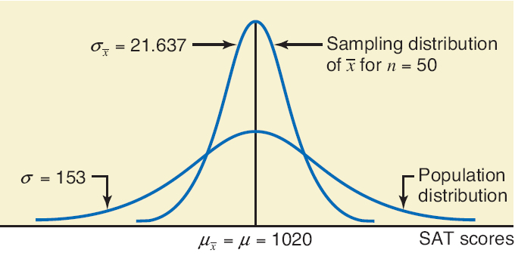
Figure 7.4
Prem Mann, Introductory Statistics, 8/E Copyright © 2013 John Wiley & Sons. All rights reserved.

Slide 42
Example 7-3: Solution
(c)
Prem Mann, Introductory Statistics, 8/E Copyright © 2013 John Wiley & Sons. All rights reserved.

Slide 43
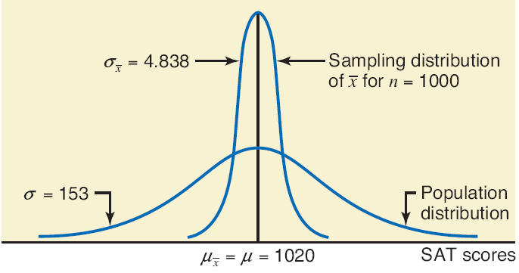
Figure 7.5
Prem Mann, Introductory Statistics, 8/E Copyright © 2013 John Wiley & Sons. All rights reserved.

Slide 44
Sampling From a Population That Is Not Normally Distributed
Central Limit Theorem
According to the central limit theorem, for a large sample
size, the sampling distribution of is approximately normal,
irrespective of the shape of the population distribution. The
mean and standard deviation of the sampling distribution of
are
The sample size is usually considered to be large if n ≥ 30.
Prem Mann, Introductory Statistics, 8/E Copyright © 2013 John Wiley & Sons. All rights reserved.

Slide 45
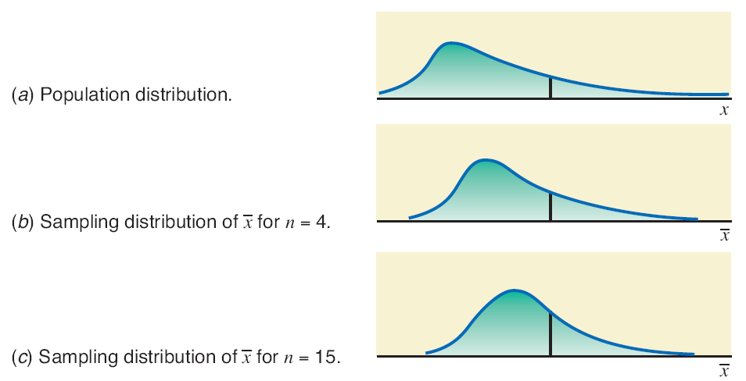
Figure 7.6 Population distribution and sampling distributions of .
Prem Mann, Introductory Statistics, 8/E Copyright © 2013 John Wiley & Sons. All rights reserved.

Slide 46
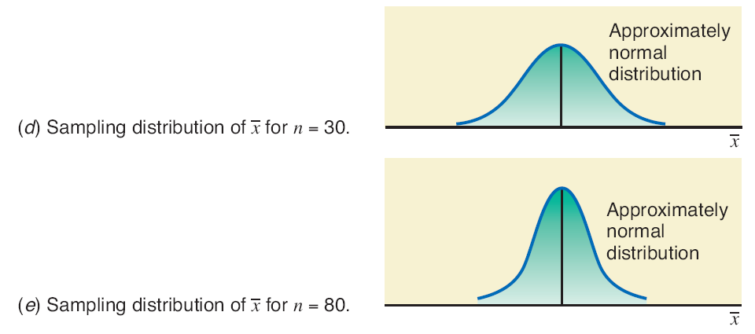
Figure 7.6 Population distribution and sampling distributions of .
Prem Mann, Introductory Statistics, 8/E Copyright © 2013 John Wiley & Sons. All rights reserved.

Slide 47

APPLICATIONS OF THE SAMPLING DISTRIBUTION OF x
1. If we take all possible samples of the same (large) size from a population and calculate the mean for each of these samples, then about 68.26% of the sample means will be within one standard deviation of the population mean.
Prem Mann, Introductory Statistics, 8/E Copyright © 2013 John Wiley & Sons. All rights reserved.

Slide 48
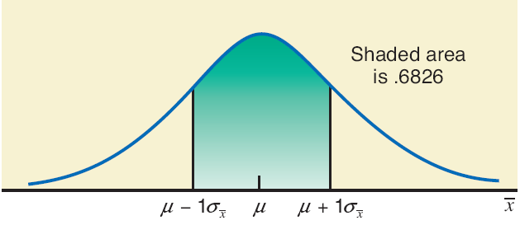
Figure 7.9
Prem Mann, Introductory Statistics, 8/E Copyright © 2013 John Wiley & Sons. All rights reserved.

Slide 49
APPLICATIONS OF THE SAMPLING DISTRIBUTION OF x
2. If we take all possible samples of the same (large) size from a population and calculate the mean for each of these samples, then about 95.44% of the sample means will be within two standard deviations of the population mean.
Prem Mann, Introductory Statistics, 8/E Copyright © 2013 John Wiley & Sons. All rights reserved.

Slide 50
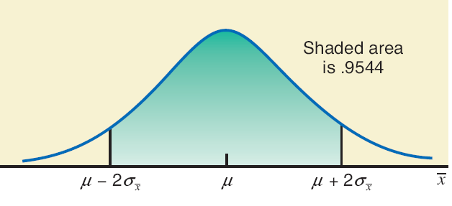
Figure 7.10
Prem Mann, Introductory Statistics, 8/E Copyright © 2013 John Wiley & Sons. All rights reserved.

Slide 51
APPLICATIONS OF THE SAMPLING DISTRIBUTION OF x
3. If we take all possible samples of the same (large) size from a population and calculate the mean for each of these samples, then about 99.74% of the sample means will be within three standard deviations of the population mean.
Prem Mann, Introductory Statistics, 8/E Copyright © 2013 John Wiley & Sons. All rights reserved.

Slide 52
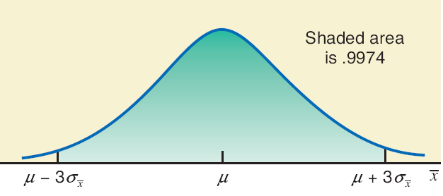
Figure 7.11
Prem Mann, Introductory Statistics, 8/E Copyright © 2013 John Wiley & Sons. All rights reserved.

Slide 53
Example 7-5
Assume that the weights of all packages of a certain brand of cookies are normally distributed with a mean of 32 ounces and a standard deviation of .3 ounce. Find the probability that the mean weight, , of a random sample of 20 packages of this brand of cookies will be between 31.8 and 31.9 ounces.
Prem Mann, Introductory Statistics, 8/E Copyright © 2013 John Wiley & Sons. All rights reserved.

Slide 54
Example 7-5: Solution
Prem Mann, Introductory Statistics, 8/E Copyright © 2013 John Wiley & Sons. All rights reserved.

Slide 55
z Value for a Value of x
The z value for a value of is calculated as
Prem Mann, Introductory Statistics, 8/E Copyright © 2013 John Wiley & Sons. All rights reserved.

Slide 56
Example 7-5: Solution
For = 31.8:
For = 31.9:
P(31.8 < < 31.9) = P(-2.98 < z < -1.49)
= P(z < -1.49) - P(z < -2.98)
= .0681 - .0014 = .0667
Prem Mann, Introductory Statistics, 8/E Copyright © 2013 John Wiley & Sons. All rights reserved.

Slide 57
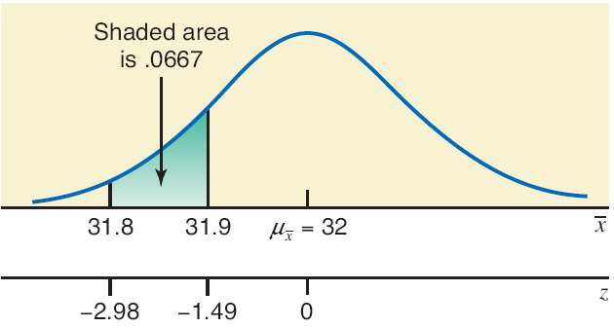
Figure 7.12
Prem Mann, Introductory Statistics, 8/E Copyright © 2013 John Wiley & Sons. All rights reserved.

Slide 58
Example 7-6
According to Moebs Services Inc., an individual checking account at major U.S. banks costs the banks between $350 and $450 per year (Time, November 21, 2011). Suppose that the current average cost of all checking accounts at major U.S. banks is $400 per year with a standard deviation of $30. Let be the current average annual cost of a random sample of 225 individual checking account at major banks in America.
Prem Mann, Introductory Statistics, 8/E Copyright © 2013 John Wiley & Sons. All rights reserved.

Slide 59
Example 7-6
(a) What is the probability that the average annual cost of the checking accounts in this sample is within $4 of the population mean?
(b) What is the probability that the average annual cost of the checking accounts in this sample is less than the population mean by $2.70 or more?
Prem Mann, Introductory Statistics, 8/E Copyright © 2013 John Wiley & Sons. All rights reserved.

Slide 60
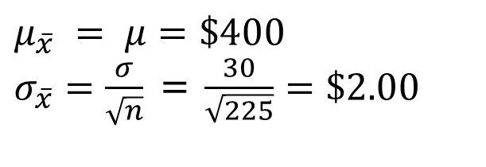
Example 7-6: Solution
μ = $400 and σ = $30. The shape of the probability distribution of the population is unknown. However, the sampling distribution of is approximately normal because the sample is large (n > 30).
$μ_{\overline{x}} = μ=\$400$
$σ_{\overline{x}}=\frac{σ}{\sqrt{n}}$ = $\frac{30}{\sqrt{225}}=\$2.00$
Prem Mann, Introductory Statistics, 8/E Copyright © 2013 John Wiley & Sons. All rights reserved.

Slide 61
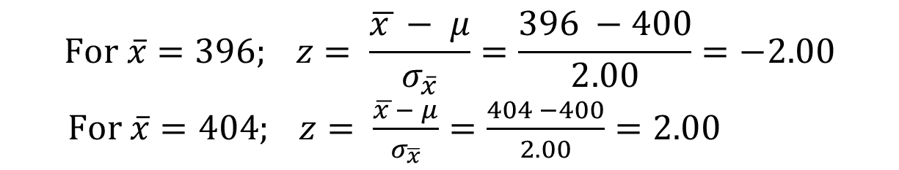
Example 7-6: Solution
(a)
P($396 ≤ ≤ $404) = P(-2.00 ≤ z ≤ 2.00)
= .9772 - .0228
= .9544
$$For \overline{x}=396; z= \frac{\overline{x }− μ}{σ_{\overline{x}}}=\frac{396 −400}{2.00}=−2.00$$
$For \overline{x}=404; z= \frac{\overline{x }− μ}{σ_{\overline{x}}}=\frac{404 −400}{2.00}=2.00$
Prem Mann, Introductory Statistics, 8/E Copyright © 2013 John Wiley & Sons. All rights reserved.

Slide 62
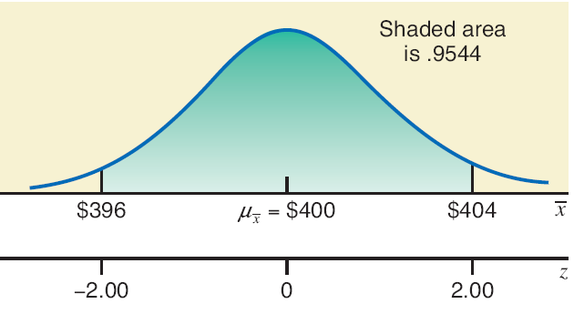

Figure 7.13
$$P(\$396 ≤\overline{x}≤\$404)$$
Prem Mann, Introductory Statistics, 8/E Copyright © 2013 John Wiley & Sons. All rights reserved.

Slide 63
Example 7-6: Solution
(a) Therefore, the probability that the average annual cost of the 225 checking accounts in this sample is within $4 of the population mean is .9544.
Prem Mann, Introductory Statistics, 8/E Copyright © 2013 John Wiley & Sons. All rights reserved.

Slide 64
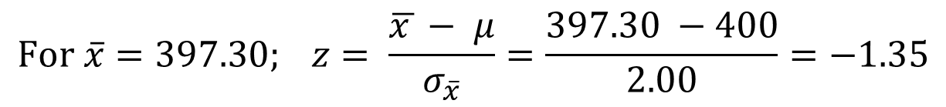
Example 7-6: Solution
(b)
P( ≤ $397.50) = P (z ≤ -1.35) = .0885
$$For \overline{x}=397.30; z= \frac{\overline{x }− μ}{σ_{\overline{x}}}=\frac{397.30 −400}{2.00}=−1.35$$
Prem Mann, Introductory Statistics, 8/E Copyright © 2013 John Wiley & Sons. All rights reserved.

Slide 65
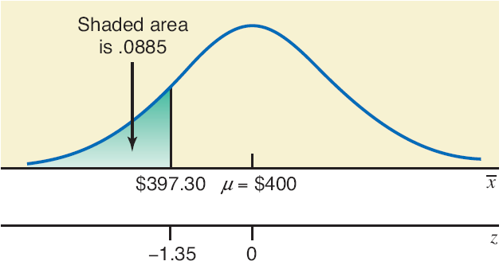

Figure 7.14
$$P(\overline{x}≤\$397.30)$$
Prem Mann, Introductory Statistics, 8/E Copyright © 2013 John Wiley & Sons. All rights reserved.

Slide 66
Example 7-6: Solution
(b) Thus, the probability that the average annual cost of the checking accounts in this sample is less than the population mean by $2.70 or more is .0885.
Prem Mann, Introductory Statistics, 8/E Copyright © 2013 John Wiley & Sons. All rights reserved.

Slide 67

POPULATION AND SAMPLE PROPORTIONS
The population and sample proportions, denoted by p and , respectively, are calculated as
Prem Mann, Introductory Statistics, 8/E Copyright © 2013 John Wiley & Sons. All rights reserved.

Slide 68
POPULATION AND SAMPLE PROPORTIONS
where
  N = total number of elements in the population
  n = total number of elements in the sample
  X = number of elements in the population that possess a specific characteristic
  x = number of elements in the sample that possess a specific characteristic
Prem Mann, Introductory Statistics, 8/E Copyright © 2013 John Wiley & Sons. All rights reserved.

Slide 69
Example 7-7
Suppose a total of 789,654 families live in a city and 563,282 of them own homes. A sample of 240 families is selected from this city, and 158 of them own homes. Find the proportion of families who own homes in the population and in the sample.
Prem Mann, Introductory Statistics, 8/E Copyright © 2013 John Wiley & Sons. All rights reserved.

Slide 70
Example 7-7: Solution
Prem Mann, Introductory Statistics, 8/E Copyright © 2013 John Wiley & Sons. All rights reserved.

Slide 71
THE SAMPLING DISTRIBUTION OF THE SAMPLE PROPORTION,
Sampling Distribution of
Mean and Standard Deviation of
Shape of the Sampling Distribution of
Prem Mann, Introductory Statistics, 8/E Copyright © 2013 John Wiley & Sons. All rights reserved.

Slide 72
Sampling Distribution of the Sample Proportion
Definition
The probability distribution of the sample proportion, , is
called its sampling distribution. It gives various values
that can assume and their probabilities.
Prem Mann, Introductory Statistics, 8/E Copyright © 2013 John Wiley & Sons. All rights reserved.

Slide 73
Example 7-8
Boe Consultant Associates has five employees. Table 7.6 gives the names of these five employees and information concerning their knowledge of statistics.
Prem Mann, Introductory Statistics, 8/E Copyright © 2013 John Wiley & Sons. All rights reserved.

Slide 74
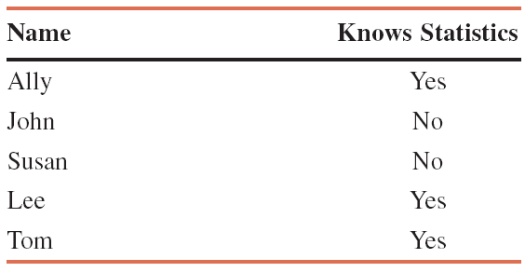
Table 7.6 Information on the Five Employees of Boe Consultant Associates
Prem Mann, Introductory Statistics, 8/E Copyright © 2013 John Wiley & Sons. All rights reserved.

Slide 75
Example 7-8: Solution
If we define the population proportion, p, as the proportion of employees who know statistics, then
p = 3 / 5 = .60
Prem Mann, Introductory Statistics, 8/E Copyright © 2013 John Wiley & Sons. All rights reserved.

Slide 76
Example 7-8: Solution
Now, suppose we draw all possible samples of three employees each and compute the proportion of employees, for each sample, who know statistics.
Prem Mann, Introductory Statistics, 8/E Copyright © 2013 John Wiley & Sons. All rights reserved.

Slide 77
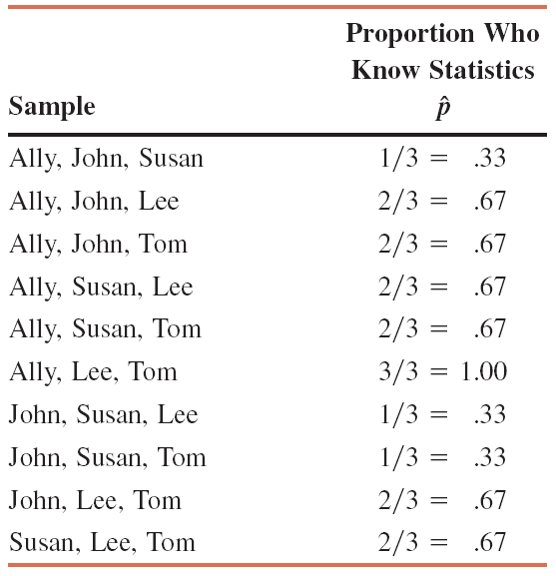
Table 7.7 All Possible Samples of Size 3 and the Value of for Each Sample
Prem Mann, Introductory Statistics, 8/E Copyright © 2013 John Wiley & Sons. All rights reserved.

Slide 78
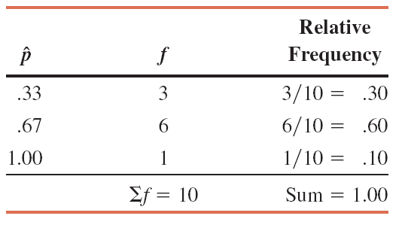
Table 7.8 Frequency and Relative Frequency Distribution of When the Sample Size Is 3
Prem Mann, Introductory Statistics, 8/E Copyright © 2013 John Wiley & Sons. All rights reserved.

Slide 79
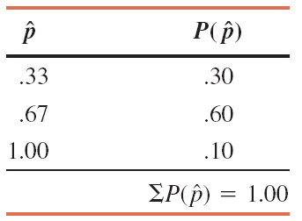
Table 7.9 Sampling Distribution of When the Sample Size is 3
Prem Mann, Introductory Statistics, 8/E Copyright © 2013 John Wiley & Sons. All rights reserved.

Slide 80
Mean and Standard Deviation of
Mean of the Sample Proportion
The mean of the sample proportion, , is denoted by and is equal to the population proportion, p. Thus,
Prem Mann, Introductory Statistics, 8/E Copyright © 2013 John Wiley & Sons. All rights reserved.

Slide 81
Mean and Standard Deviation of
Standard Deviation of the Sample Proportion
The standard deviation of the sample proportion, , is
denoted by and is given by the formula
where p is the population proportion, q = 1 – p , and n is the sample size. This formula is used when n/N ≤ .05, where N is the population size.
Prem Mann, Introductory Statistics, 8/E Copyright © 2013 John Wiley & Sons. All rights reserved.

Slide 82
Mean and Standard Deviation of
If n /N > .05, then is calculated as:
where the factor is called the finite- population
correction factor.
Prem Mann, Introductory Statistics, 8/E Copyright © 2013 John Wiley & Sons. All rights reserved.

Slide 83
Shape of the Sampling Distribution of
Central Limit Theorem for Sample Proportion
According to the central limit theorem, the sampling
distribution of is approximately normal for a sufficiently
large sample size. In the case of proportion, the sample
size is considered to be sufficiently large if np and nq are
both greater than 5 – that is, if
np > 5 and nq >5
Prem Mann, Introductory Statistics, 8/E Copyright © 2013 John Wiley & Sons. All rights reserved.

Slide 84
Example 7-9
According to a New York Times/CBS News poll conducted
during June 24-28, 2011, 55% of adults polled said that
owning a home is a very important part of the American
Dream (The New York Times, June 30, 2011). Assume that
this result is true for the current population of American
adults. Let be the proportion of American adults in a
random sample of 2000 who will say that owning a home is
a very important part of the American Dream. Find the
mean and standard deviation of and describe the shape
of its sampling distribution.
Prem Mann, Introductory Statistics, 8/E Copyright © 2013 John Wiley & Sons. All rights reserved.

Slide 85
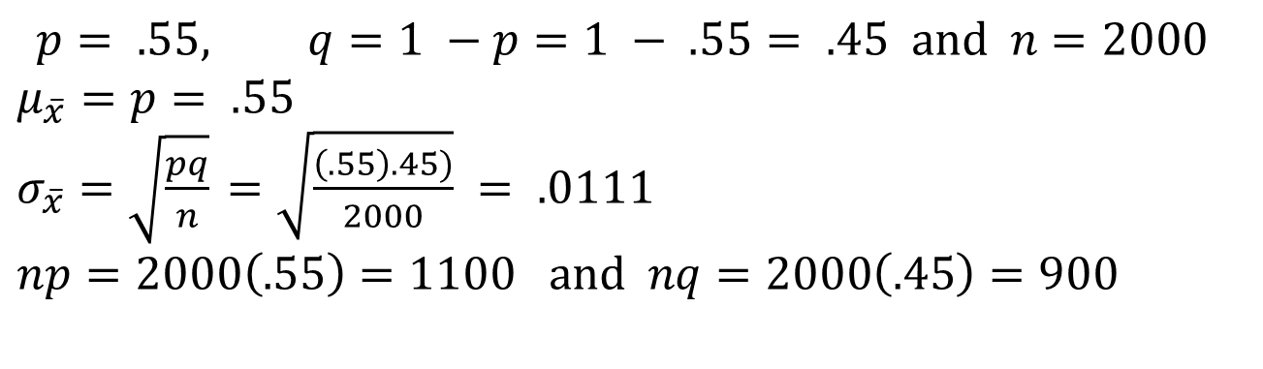
Example 7-9: Solution
$$p= .55, q=1 −p=1 − .55= .45 and n=2000$$
$μ_{\overline{x}}=p= .55$
$σ_{\overline{x}}=\sqrt{\frac{pq}{n}}$ $=\sqrt{\frac{\left(.55\right).45)}{2000}} = .0111$
$np=2000\left(.55\right)=1100 and nq=2000\left(.45\right)=900$
Prem Mann, Introductory Statistics, 8/E Copyright © 2013 John Wiley & Sons. All rights reserved.

Slide 86
Example 7-9: Solution
np and nq are both greater than 5.
Therefore, the sampling distribution of is approximately normal (by the central limit theorem) with a mean of .55 and a standard deviation of .0111, as shown in Figure 7.15.
Prem Mann, Introductory Statistics, 8/E Copyright © 2013 John Wiley & Sons. All rights reserved.

Slide 87
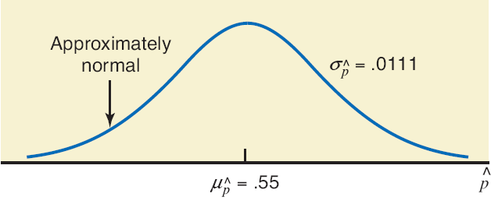
Figure 7.15
Prem Mann, Introductory Statistics, 8/E Copyright © 2013 John Wiley & Sons. All rights reserved.

Slide 88

Applications of the Sampling Distribution of
When we conduct a study, we usually take only one
sample and make all decisions or inferences on the basis of
the results of that one sample. We use the concepts of the
mean, standard deviation, and shape of the sampling
distribution of to determine the probability that the
value of computed from one sample falls within a given
interval.
Prem Mann, Introductory Statistics, 8/E Copyright © 2013 John Wiley & Sons. All rights reserved.

Slide 89
Example 7-10
According to a Pew Research Center nationwide telephone survey of American adults conducted by phone between March 15 and April 24, 2011, 75% of adults said that college education has become too expensive for most people and they cannot afford it (Time, May 30, 2011). Suppose that this result is true for the current population of American adults. Let be the proportion in a random sample of 1400 adult Americans who will hold the said opinion. Find the probability that 76.5% to 78% of adults in this sample will hold this opinion.
Prem Mann, Introductory Statistics, 8/E Copyright © 2013 John Wiley & Sons. All rights reserved.

Slide 90
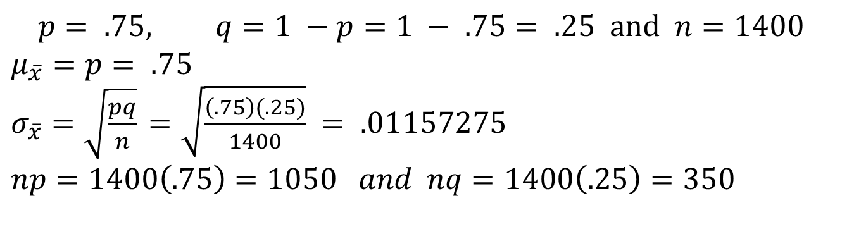
Example 7-10: Solution
$$p= .75, q=1 −p=1 − .75= .25 and n=1400$$
$μ_{\overline{x}}=p= .75$
$σ_{\overline{x}}=\sqrt{\frac{pq}{n}}$ $=\sqrt{\frac{\left(.75\right)(.25)}{1400}} = .01157275$
$np=1400\left(.75\right)=1050 and nq=1400\left(.25\right)=350$
We can infer from the central limit theorem that the sampling distribution of is approximately normal.
Prem Mann, Introductory Statistics, 8/E Copyright © 2013 John Wiley & Sons. All rights reserved.

Slide 91
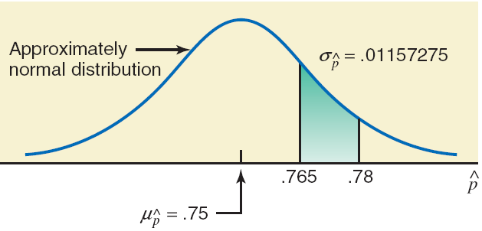

Figure 7.16
$$P(.765<\hat{p}< .78)$$
Prem Mann, Introductory Statistics, 8/E Copyright © 2013 John Wiley & Sons. All rights reserved.

Slide 92
z Value for a Value of
The z value for a value of is calculated as
Prem Mann, Introductory Statistics, 8/E Copyright © 2013 John Wiley & Sons. All rights reserved.

Slide 93
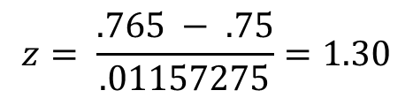
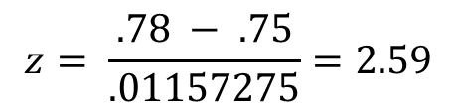
Example 7-10: Solution
For = .765:
For = .78:
P(.765 < < .78) = P(1.30 < z < 2.59)
= .9952 - .9032
= .0920
$$z= \frac{.765 − .75}{.01157275}=1.30$$
$$z= \frac{.78 − .75}{.01157275}=2.59$$
Prem Mann, Introductory Statistics, 8/E Copyright © 2013 John Wiley & Sons. All rights reserved.

Slide 94
Example 7-10: Solution
Thus, the probability that is between .765 and .78 is given by the area under the standard normal curve between z = 1.30 and z = 2.59. This area is shown in Figure 7.17. The required probability is
P(.765 < < .78) = P(1.30 < z < 2.59)
= .9952 - .9032
= .0920
Prem Mann, Introductory Statistics, 8/E Copyright © 2013 John Wiley & Sons. All rights reserved.

Slide 95
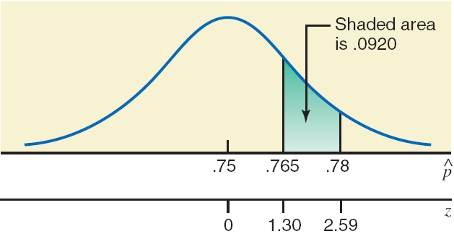
Figure 7.17
$$P(.765<\hat{p}< .78)$$
Prem Mann, Introductory Statistics, 8/E Copyright © 2013 John Wiley & Sons. All rights reserved.

Slide 96
Example 7-11
Maureen Webster, who is running for mayor in a large city, claims that she is favored by 53% of all eligible voters of that city. Assume that this claim is true. What is the probability that in a random sample of 400 registered voters taken from this city, less than 49% will favor Maureen Webster?
Prem Mann, Introductory Statistics, 8/E Copyright © 2013 John Wiley & Sons. All rights reserved.

Slide 97
Example 7-11: Solution
n =400, p = .53, and q = 1 – p = 1 - .53 = .47
Prem Mann, Introductory Statistics, 8/E Copyright © 2013 John Wiley & Sons. All rights reserved.

Slide 98
Example 7-11: Solution
P( < .49) = P(z < -1.60) = .0548
Hence, the probability that less than 49% of the voters in a random sample of 400 will favor Maureen Webster is .0548.
Prem Mann, Introductory Statistics, 8/E Copyright © 2013 John Wiley & Sons. All rights reserved.

Slide 99
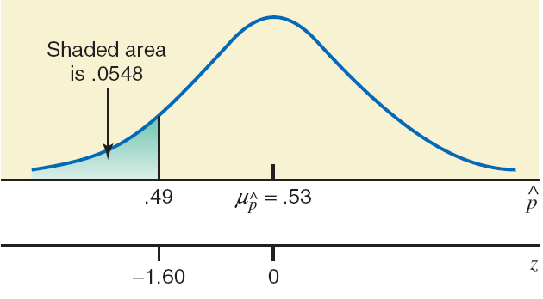
Figure 7.18
Prem Mann, Introductory Statistics, 8/E Copyright © 2013 John Wiley & Sons. All rights reserved.

